Slide 1
Day 9 & Day 10
Test Case Preparation
Resume Preparation

Slide 2
Test cases and software quality
Test Case
A document that specifies the test inputs, execution conditions, and predicted results for an item to be tested with respect to the testing criteria.

Slide 3
Test Case (TC)
A good TC is one that has a high probability of finding an error
A successful TC is one that detects an as-yet undiscovered error

Slide 4
What is a good test case?
Accurate - tests what it’s designed to test
Economical - no unnecessary steps
 Repeatable, reusable - keeps on going
 Traceable - to a requirement
 Appropriate - for test environment, testers
 Self standing - independent of the writer
 Self cleaning - picks up after itself

Slide 5
Types of test cases
 Step-by-step or word/action instructions
 Table, matrix
 Script for record/playback or performance test
 All need the same structure (anatomy)

Slide 6
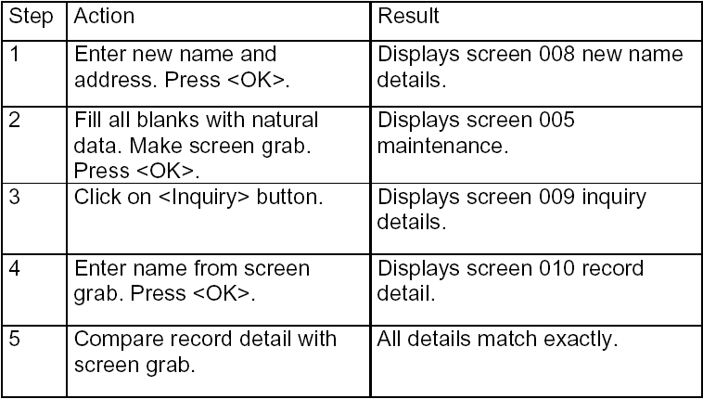
Step-by-step

Slide 7
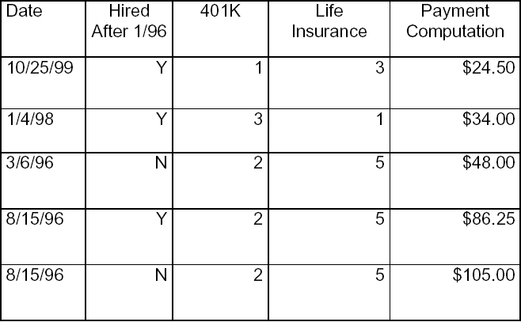
Data matrix

Slide 8
Automated script
# Open the Fax Form
menu_select_item ("File;Fax Order...");
set_window("Fax Order");
# Retrieve the Fax Order information and compare it to data from
the main window
edit_get_text("Arrival:", text);
if(main_data["arr_time"] != text)
{
failure_msg = arrival_fr_mismatch;
result = FAIL;

Slide 9
Anatomy/ Structure of a test case
 Statement of purpose, what is being tested
 Method, how it will be tested
 Setup, environment, data
 Steps - actions and expected results, implied in a table or matrix
 Proofs, files, printouts, reports, screen grabs
(optional)

Slide 10
When to use each type of case
 Step by step case - unique transactions, rules
 Matrix or table - mostly same + variable
 Automated script - key is organization support

Slide 11
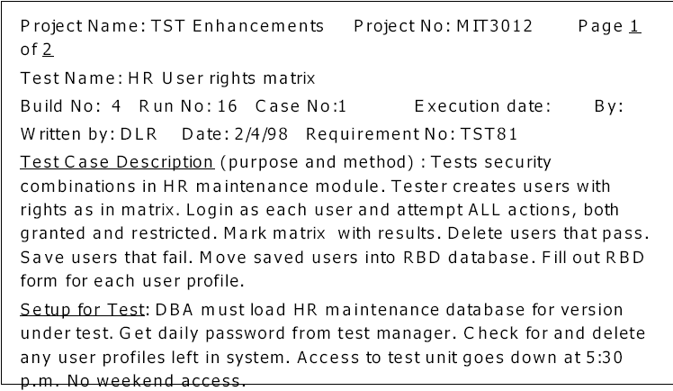
Sample set up

Slide 12
Test Case Format
Test case ID - The test case id must be unique across the application
Test case description - The test case description must be very brief.
Test prerequisite - The test pre-requisite clearly describes what should be present in the system, before the test can be executes.
Test Inputs - The test input is nothing but the test data that is prepared to be fed to the system.
Test steps - The test steps are the step-by-step instructions on how to carry out the test.
Expected Results - The expected results are the ones that say what the system must give as output or how the system must react based on the test steps.

Slide 13
Test Case Format
Actual Results – The actual results are the ones that say outputs of the action for the given inputs or how the system reacts for the given inputs.
Pass/Fail - If the Expected and Actual results are same then test is Pass otherwise Fail.
Test Cases are classified into positive and negative test cases
Positive test cases are designed to prove that the system accepts the valid inputs and then process them correctly. Suitable techniques to design the positive test cases are Equivalence partitioning etc.
Negative test cases are designed to prove that the system rejects invalid inputs and does not process them. Suitable techniques to design the negative test cases are Error guessing, Boundary value analysis.

Slide 14
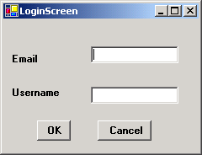
Unit Test Cases (UTC)
These are very specific to a particular unit. The basic functionality of the unit is to be understood based on the requirements and the design documents.
For example, In the Online shopping application, If the user enters valid Email id and Username values, let us assume that Design document says, that the system must display a product details and should insert the Email id and Username in database table. If user enters invalid values the system will display appropriate error message and will not store it in database
Snapshot of Login Screen

Slide 15
Unit Test Cases (UTC)
Test Conditions for the fields in the Login screen
Email-It should be in this format (For Eg clickme@yahoo.com).
Username – It should accept only alphabets not greater than 6. Numerics and special type of characters are not allowed.
Test Prerequisite: The user should have access to Customer Login screen form screen

Slide 16
Unit Test Cases (UTC)
Negative Test Case
Test #
Description
Test Inputs
Expected Results
Actual results
Pass/Fail
1
Check for inputting values in Email field
Email=keerthi@rediffmail
Username=Xavier
Inputs should not be accepted. It should display message “Enter valid Email”
2
Check for inputting values in Email field
Email=john26#rediffmail.com
Username=John
Inputs should not be accepted. It should display message “Enter valid Email”
3
Check for inputting values in Username field
Email=shilpa@yahoo.com
Username=Mark24
Inputs should not be accepted. It should display message “Enter correct Username”

Slide 17
Unit Test Cases (UTC)
Positive Test Case
Test #
Description
Test Inputs
Expected Results
Actual results
Pass/Fail
1
Check for inputting values in Email field
Email=shan@yahoo.com
Username=dave
Inputs should be accepted.
2
Check for inputting values in Email field
Email=knki@rediffmail.com
Username=john
Inputs should be accepted.
3
Check for inputting values in Username field
Email=xav@yahoo.com
Username=mark
Inputs should be accepted.

Slide 18
Integration Test Cases
The main aim of integration test cases is that it tests the multiple modules together. By executing these test cases the user can find out the errors in the interfaces between the Modules
For example, in online shopping, there will be Catalog and Administration module. In catalog section the customer can track the list of products and can buy the products online. In administration module the admin can enter the product name and information related to it.

Slide 19
Integration Test Cases
Test #
Description
Test Inputs
Expected Results
Actual results
Pass/Fail
1
Check for Login Screen
Enter values in Email and UserName.
For Eg:
Email =shilpa@yahoo.com
Username=shilpa
Inputs should be accepted.
Backend Verification
Select email, username from Cus;
The entered Email and Username should be displayed at sqlprompt.
2
Check for Product Information
Click product information link
It should display complete details of the product
3
Check for admin screen
Enter values in Product Id and Product name fields.
For Eg:
Product Id-245
Product name-Norton Antivirus
Inputs should be accepted.
Backend verification
Select pid , pname from Product;
The entered Product id and Product name should be displayed at the sql prompt.

Slide 20
Improving testability - language
 Testability = easy to test
 Use active case, do this, do that
 System displays this, does that
 Simple, conversational language
 Exact, consistent names of fields, not generic
 Don’t explain Windows basics

Slide 21
Improving testability - length
 10-15 steps
 Uniform time to test
 Wide range of testers
 Order of cases follows business scenarios

Slide 22
Improving productivity
with templates
 Prevents blank page panic
 Assists the disorganized
 Builds in standards
 Prints spiffy looking tests
 Assists testers to find information

Slide 23
Improving productivity with
test management software
 Single best investment to improve productivity
 Makes outlining and writing easier
 Allows cloning (copying) of steps, cases, sets
 Easy to add, move, delete cases and steps
 Automatically renumbers

Slide 24
The seven most common mistakes
 Making cases too long
 Incomplete, incorrect, or incoherent setup
 Leaving out a step
 Naming fields that changed or no longer exist
 Unclear whether tester or system does action
 Unclear what is a pass or fail result
 Failure to clean up

Slide 25
Sudden project changes
Requirements changes - be informed, build in variables, make deals
Schedule changes - impact of delay
Staff changes - software knowledge first, requirements, prototypes, test cases

Slide 26
Sample Test Cases
Sample 1 (Word doc)
Sample 2 (Excel sheet)

Slide 27
Metrics for Testing
What is a Metric?
‘Metric’ is a measure to quantify software, software development resources, and/or the software development process. A Metric can quantify any of the following factors:
Schedule,
Work Effort,
Product Size,
Project Status,
Quality Performance

Slide 28
Metrics for Testing
Defect Density: (No. Of Defects Reported by SQA + No. Defects Reported By Peer Review)/Actual Size.
Defect Removal Efficiency: (Total No Of Defects Removed /Total No. Of Defects Injected)*100 at various stages of SDLC
Schedule Variance (SV): This metric gives the variation of actual schedule vs. the planned schedule. This is calculated for each project – stage wise.
SV = [(Actual no. of days – Planned no. of days) / Planned no. of days] * 100
Effort Variance (EV): This metric gives the variation of actual effort vs. the estimated effort. This is calculated for each project Stage wise
EV = [(Actual person hours – Estimated person hours) / Estimated person hours] * 100

